Slide 1
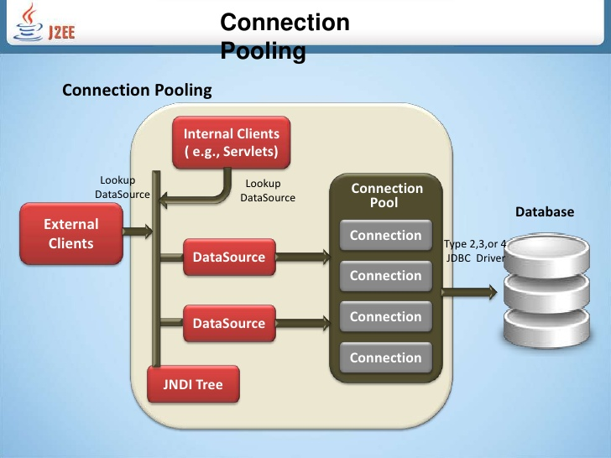
What is connection Pool?
A connection Pool is a cache of database connections(connection object) maintained in the database memory so that the connection can be reused when the database receives future request for data.

Slide 2
How connection pool works?
Connection pooling shares connections across different user requests to maintain performance and reduce the number of new connections that must be created. Compare the following transaction sequences to picture the efficiency offered by pooling connections.
Without Connection Pooling: With Connection Pooling:
The application creates a connection. 1)The application request a connection from the
The application sends a query to the DataDirect connection pool
Cloud connectivity services 2)If unused connection exists,it is returned by the pool
The application obtains query results otherwise pool create a new connection.
The application displays the results to the end 3)The application send a query tothe DataDirectCloud
User connectivity services
The application ends the connection 4)The applications obtains query results.
5) The application displays the results to the end user
6)The application closes the connection which returns e the connection to the pool

Slide 3
Connection pool uses in performance
One of the most time consuming procedures of a database application is establishing a connection to the database. Use connection pooling to minimize this overhead.
Use connection pools and cached prepared statements for database access.
Use the same connections to execute multiple statements.
Keep connection objects open and reuse them, rather than repeatedly connecting and disconnecting.
Connection pools should have associated Prepared Statement caches so that the prepared statements are automatically reused.
http://www.javaperformancetuning.com/tips/jdbcconnpool.shtml

Slide 4
C3po & tomcat JDBC
C3po is (open source JDBC connection pool)easy to use library for Driver Manager-based JDBC with JNDI bindable Data sources, including data sources that implement connection and statement pooling.
Java Database connectivity is a technology that allows java technology to allows java technologies to connect to a wide variety of database types

Slide 5
Statement caching
Statement caching improves performance by caching executable statements that are used repeatedly , such as in a loop or in a method that is called repeadly.
Statement caching can:
(1)Prevent the overhead of repeated cursor creation
(2)Prevent repeated statement parsing and creation
(3)Reuse data structures in the client side
There are 2 types of statement caching:(1)Implicit(2)Explicit
https://docs.oracle.com/cd/B10501_01/java.920/a96654/stmtcach.htm

Slide 6
Statement caching types
Implicit: When you enable implicit statement caching,JDBC automatically caches the callable statement when you call the close() method of this statement object.
Enabling & Disabling implicit statement caching:
Enable implicit statement caching in one of two ways as below:
Invoking setImplicitStatementCaching(true) on the connection.
Invoking OracleDataSource.getConnection () with the ImplicitStatementCachingEnabled property set to true; you set ImplicitStatementCachingEnabled by calling OracleDataSource.setImplicitStatementCachingEnabled(true)
Disabling:Disable implicit statement caching by invoking setImplicitStatementCaching(false) on the connection or by setting the ImplicitStatementCachingEnabled property to false
https://docs.oracle.com/cd/B10501_01/java.920/a96654/stmtcach.htm

Slide 7
Diff Option in implicit statement
The SQL string in the statement must be identical (case-sensitive) to one in the cache.
The statement type must be the same (prepared or callable).
The scrollable type of result sets produced by the statement must be the same (forward-only or scrollable). You can determine the scrollability when you create the statement
Note:The JDBC driver does not clear metadata. However, although metadata is saved for performance reasons, it has no semantic impact. A statement that comes from the implicit cache appears as if it were newly created.
https://docs.oracle.com/cd/B10501_01/java.920/a96654/stmtcach.htm

Slide 8
Explicit statement caching
Explicit:Explicit statement caching enables you to cache and retrieve selected prepared, callable, and plain statements. Explicit statement caching relies on a key, an arbitrary Java string that you provide.
Enabling & Disabling Explicit statement caching:
To enable explicit statement caching you must first set the application cache size. You set the cache size in one of two ways.
1) invoking OracleConnection.setStatementCacheSize() on the physical connection
2) invoking OracleDatasource.setMaxStatements()
Disabling:The following code disables explicit statement caching.
((OracleConnection)conn).setExplicitStatementCaching(false);
https://docs.oracle.com/cd/B10501_01/java.920/a96654/stmtcach.htm

Slide 9
Diff options in Explicit
A plain, prepared, or callable statement can be explicitly cached when you enable explicit statement caching. Explicit statement caching includes the following steps.
Allocate a statement using one of the standard methods.
Explicitly cache the statement by closing it with a key, using the closeWithKey() method.
Retrieve the explicitly cached statement by calling the appropriate Oracle "WithKey" method, specifying the appropriate key.
Re-cache an open, explicitly cached statement by closing it again with the closeWithKey() method. Each time a cached statement is closed, it is re-cached with its key.
https://docs.oracle.com/cd/B10501_01/java.920/a96654/stmtcach.htm

Slide 10
connection Pool
Physical connections
Virtual connections
DB
Connection pools
Client

